Slide 1
Bias in OLAP Queries: Detection, Explanation, and Removal (Or Think Twice About Your AVG-Query)
SIGMOD 2018
Babak Salimi*, Dan Suciu*, Johannes Gehrke⁺
*University of Washington ⁺Microsoft

Slide 2
Biased OLAP queries
Decision support technologies aimed at enabling the knowledge worker to make better/faster decisions
The database community has been focused only on the performance requirements of such technologies
We show OLAP queries can be biased and lead to incorrect business decisions
Notes:
(1) Such as OLAP
(2) rather than the functional requirements
(3) (no matter how big is your data and how fast you can process it)
++++++++++++
the knowledge worker (executive, manager, analyst)
A data warehouse is a “subject-oriented, integrated, timevarying, non-volatile collection of data that is used primarily in organizational decision making
(1) Enterprise need to make decision typically related to allocating
scarce resources such as time/people/ money. Thus, they need tools to assist them to evaluate the consequence of
choosing between different policies and alternatives.
In database community we realize that there are valuable information in historical data
(such as money, equipment, food, medicine,
people, or time, and usually in the face of uncertainty.)
(2) In this paper we express our doubt about this. You you may share the same view with us after

Slide 3
The Pitfall of Group BY Queries for Decision Making
Suppose a company wants to choose between the business travel programs offered by American and United
Q: Which airline has a better on-time performance?
Notes:
===============
Suppose a company has many business flights from four airports, and wants to subscribe to a business travel plan with either AA or UA, depending on which has the best on time performance at those four airports. Thus, the decision of which ariline to choose depends on the on-time performance of the airline.
Rochester (ROC), Montrose (MTJ), McAllen Miller (MFE) and Colorado Springs (COS).

Slide 4
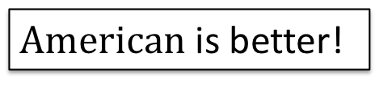
The Pitfall of Group BY Queries for Decision Making
Q: Which airline has a better on-time performance?
SELECT Carrier, avg(Delayed)
FROM FlightData WHERE Carrier IN (American, United ) GROUP BY Carrier
[Airline On-Time
Performance Data]
$American$is better!
Notes:
But this seems to be a wrong decision!

Slide 5
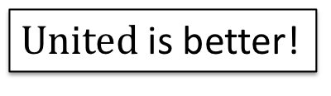
The Pitfall of Group BY Queries for Decision Making
Q: Which airline has a better on-time performance?
SELECT Carrier, Airport ,avg(Delayed)
FROM FlightData WHERE Carrier IN (American, United ) GROUP BY Carrier, Airport
[Airline On-Time
Performance Data]
$American$is better!
$United$is better!
Notes:
Once you Drill-down in airport …
Although the average delay of AA is lower than UA, AA has a higher delay at every single airport. This is called in statistics “Simpson’s paradox” and happens because of overlooking the so-called confounders or confounding variables! What the user really want is to compute the causal effect of choosing UA or AA on the delay of its travelers. The original SQL fails to answer this, because, as I explain later, it is “biased”;
instead the correct query that finds the causal effect averages AFTER computing the delay per each airport.
In this talk we study the following problem: Given a group by query intended to measure causal effect, we detect whether it is biased, we measure and report the bias, and we repair automatically the query.
The anomaly happens because of overlooking the so-called confounders or confounding variables!

Slide 6
Our System: HypDB
Detecting bias:
A new definition of a biased query
A novel algorithm to learn factors that lead to bias
Explaining Bias: novel techniques to find ranked explanations for the bias
Removing Bias: query rewriting technique to eliminate the bias from queries
Notes:
we propose HypDB, a system to detect, explain, and
resolve bias in decision-support queries.
We a new formal definition of a biased query that enables the
system to detect bias in OLAP queries by performing a set of independence
tests on the data. In particular our system automatically infers confounders that are responsible for bias.
Before discussing our contributions, let see how statistics would model causal queries!

Slide 7
Background: Rubin’s Causality Model
What is the effect on Y if we change T?
Treatment T
Outcome Y
Carrier | Year | Airport | DayofWeek | … | Delayed | Delayed(AA) | Delayed(UA)
AA | 2016 | ROC | 1 | .. | 0 | 0 | missing
AA | 2017 | COS | 5 | .. | 1 | 1 | missing
UA | 2016 | COS | 1 | .. | 0 | missing | 0
UA | 2018 | ROC | 5 | .. | 1 | missing | 1
Notes:
Before discussing the details of our system I need to throw at you some baclground on causality
The basic framework in statistics to model causality is that of Rubin’s
++++++++++++++++++++++++
The question that we are interested in in causality is what would be the effect of chancing the treatment variable on an outcome of interest.
In our case the treatment is the choice of the carriers and the outcome is the delay
What would be the average delay if all flights were by AA?

Slide 8
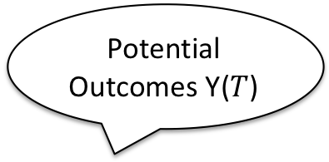
Background: Rubin’s Causality Model
What is the effect on Y if we change T?
Potential Outcomes Y($T$)
Treatment T
Outcome Y
Carrier | Year | Airport | DayofWeek | … | Delayed | Delayed(AA) | Delayed(UA)
AA | 2016 | ROC | 1 | .. | 0 | 0 | 1
AA | 2017 | COS | 5 | .. | 1 | 1 | 1
UA | 2016 | COS | 1 | .. | 0 | 1 | 0
UA | 2018 | ROC | 5 | .. | 1 | 0 | 1
Notes:
When we think about causal effect we are going to be really thinking about …
When I say treatment I really mean it generically, it’s a thing that you want to know how does it effect an outcome of interest.
Of course we can have multipole levels of treatment but to keep things simple we assume T is a binary attribute and Y is a continues attribute.
Think of potential outcome as the outcome observed on each particular level of treatment.
For example delayed(AA) is the delay observed for each flight if carrier was AA.
Here the goal is to answer the question …
What would be the average delay if all flights were by AA?
If this particular flight were by UA then it would have been delayed
=====
Use a counterfactual and operate by term

Slide 9
Background: Rubin’s Causality Model
What is the effect on Y if we change T?
Naive Query= E[Y|T=1] – E[Y|T=1]
Potential Outcomes Y($T$)
Treatment T
Outcome Y
Carrier | Year | Airport | DayofWeek | … | Delayed | Delayed(AA) | Delayed(UA)
AA | 2016 | ROC | 1 | .. | 0 | 0 | 1
AA | 2017 | COS | 5 | .. | 1 | 1 | 1
UA | 2016 | COS | 1 | .. | 0 | 1 | 0
UA | 2018 | ROC | 5 | .. | 1 | 0 | 1

Slide 10
Background: Rubin’s Causality Model
What is the effect on Y if we change T?
Naive Query= E[Y|T=1] – E[Y|T=1]
Potential Outcomes Y($T$)
Treatment T
Outcome Y
Carrier | Year | Airport | DayofWeek | … | Delayed | Delayed(AA) | Delayed(UA)
AA | 2016 | ROC | 1 | .. | 0 | 0 | 1
AA | 2017 | COS | 5 | .. | 1 | 1 | 1
UA | 2016 | COS | 1 | .. | 0 | 1 | 0
UA | 2018 | ROC | 5 | .. | 1 | 0 | 1

Slide 11
Background: Rubin’s Causality Model
What is the effect on Y if we change T?
Naive Query= E[Y|T=1] – E[Y|T=1]
Potential Outcomes Y($T$)
Treatment T
Outcome Y
Carrier | Year | Airport | DayofWeek | … | Delayed | Delayed(AA) | Delayed(UA)
AA | 2016 | ROC | 1 | .. | 0 | 0 | 1
AA | 2017 | COS | 5 | .. | 1 | 1 | 1
UA | 2016 | COS | 1 | .. | 0 | 1 | 0
UA | 2018 | ROC | 5 | .. | 1 | 0 | 1

Slide 12
Background: Rubin’s Causality Model
What is the effect on Y if we change T?
Naive Query= E[Y|T=1] – E[Y|T=1]
Average Treatment Effect (ATE)= E[Y(T=1)] – E[Y(T=0)]
Potential Outcomes Y($T$)
Treatment T
Outcome Y
Carrier | Year | Airport | DayofWeek | … | Delayed | Delayed(AA) | Delayed(UA)
AA | 2016 | ROC | 1 | .. | 0 | 0 | 1
AA | 2017 | COS | 5 | .. | 1 | 1 | 1
UA | 2016 | COS | 1 | .. | 0 | 1 | 0
UA | 2018 | ROC | 5 | .. | 1 | 0 | 1
Notes:
Ideally we would like to see two version of the world: in the first version all flight were by AA and and in the second version all flight were by UA
Now we can take the difference between the average of delayed in two alternative world.
What would be the average delay if all flights were by AA?
Given these two potential outcomes the answer to the query that we started with is the difference between the average of the potential outcomes!
In our example, ATE shows exactly which airline has a better performance.

Slide 13
Background: Rubin’s Causality Model
What is the effect on Y if we change T?
Naive Query= E[Y|T=1] – E[Y|T=1]
Average Treatment Effect (ATE)= E[Y(T=1)] – E[Y(T=0)]
Potential Outcomes Y($T$)
Treatment T
Outcome Y
Carrier | Year | Airport | DayofWeek | … | Delayed | Delayed(AA) | Delayed(UA)
AA | 2016 | ROC | 1 | .. | 0 | 0 | 1
AA | 2017 | COS | 5 | .. | 1 | 1 | 1
UA | 2016 | COS | 1 | .. | 0 | 1 | 0
UA | 2018 | ROC | 5 | .. | 1 | 0 | 1

Slide 14
Background: Rubin’s Causality Model
What is the effect on Y if we change T?
Naive Query= E[Y|T=1] – E[Y|T=1]
Average Treatment Effect (ATE)= E[Y(T=1)] – E[Y(T=0)]
Potential Outcomes Y($T$)
Treatment T
Outcome Y
Carrier | Year | Airport | DayofWeek | … | Delayed | Delayed(AA) | Delayed(UA)
AA | 2016 | ROC | 1 | .. | 0 | 0 | 1
AA | 2017 | COS | 5 | .. | 1 | 1 | 1
UA | 2016 | COS | 1 | .. | 0 | 1 | 0
UA | 2018 | ROC | 5 | .. | 1 | 0 | 1

Slide 15
Background: Rubin’s Causality Model
What is the effect on Y if we change T?
Naive Query= E[Y|T=1] – E[Y|T=1]
Average Treatment Effect (ATE)= E[Y(T=1)] – E[Y(T=0)]
Potential Outcomes Y($T$)
Treatment T
Outcome Y
Carrier | Year | Airport | DayofWeek | … | Delayed | Delayed(AA) | Delayed(UA)
AA | 2016 | ROC | 1 | .. | 0 | 0 | missing
AA | 2017 | COS | 5 | .. | 1 | 1 | missing
UA | 2016 | COS | 1 | .. | 0 | missing | 0
UA | 2018 | ROC | 5 | .. | 1 | missing | 1
Notes:
Counterfactuals outcomes are one that would have been observed had treatment been different.
What would have been the delay of the flight had the flight been operated by UA

Slide 16
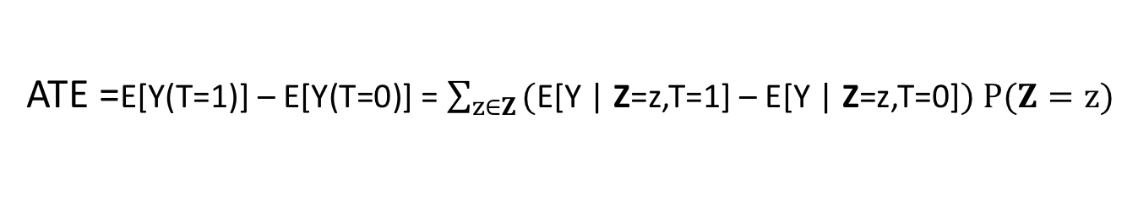
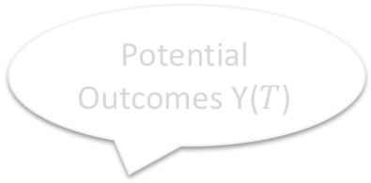
Background: Rubin’s Causality Model
What is the effect on Y if we change T?
Naive Query= E[Y|T=1] – E[Y|T=1]
Average Treatment Effect (ATE)= E[Y(T=1)] – E[Y(T=0)]
Potential Outcomes Y($T$)
Treatment T
Outcome Y
Carrier | Year | Airport | DayofWeek | … | Delayed | Delayed(AA) | Delayed(UA)
AA | 2016 | ROC | 1 | .. | 0 | 0 | missing
AA | 2017 | COS | 5 | .. | 1 | 1 | missing
UA | 2016 | COS | 1 | .. | 0 | missing | 0
UA | 2018 | ROC | 5 | .. | 1 | missing | 1
If stuffiest “Confounders” Z are available then:
ATE =E[Y(T=1)] – E[Y(T=0)] = $\sum_{z∈Z}{\text{(}\text{E}\text{[}\text{Y}\text{ | }\text{Z}\text{=}\text{z}\text{,}\text{T}\text{=1] – }\text{E}\text{[}\text{Y}\text{ | }\text{Z}\text{=}\text{z}\text{,}\text{T}\text{=0]}) P(Z=z)}$
Notes:
What would be the average delay if all flights were by AA?

Slide 17
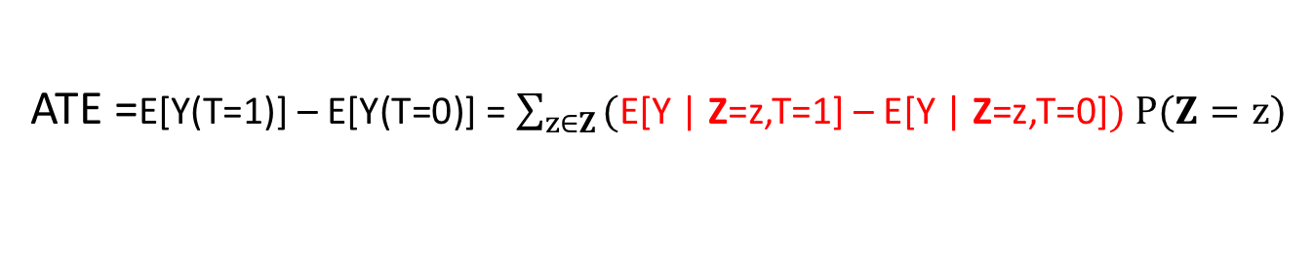
Background: Rubin’s Causality Model
What is the effect on Y if we change T?
Naive Query= E[Y|T=1] – E[Y|T=1]
Average Treatment Effect (ATE)= E[Y(T=1)] – E[Y(T=0)]
Potential Outcomes Y($T$)
Treatment T
Outcome Y
Carrier | Year | Airport | DayofWeek | … | Delayed | Delayed(AA) | Delayed(UA)
AA | 2016 | ROC | 1 | .. | 0 | 0 | missing
AA | 2017 | COS | 5 | .. | 1 | 1 | missing
UA | 2016 | COS | 1 | .. | 0 | missing | 0
UA | 2018 | ROC | 5 | .. | 1 | missing | 1
If stuffiest “Confounders” Z are available then:
ATE =E[Y(T=1)] – E[Y(T=0)] = $\sum_{z∈Z}{\text{(}\text{E}\text{[}\text{Y}\text{ | }\text{Z}\text{=}\text{z}\text{,}\text{T}\text{=1] – }\text{E}\text{[}\text{Y}\text{ | }\text{Z}\text{=}\text{z}\text{,}\text{T}\text{=0]}) P(Z=z)}$

Slide 18
Background: Rubin’s Causality Model
What is the effect on Y if we change T?
Naive Query= E[Y|T=1] – E[Y|T=1]
Average Treatment Effect (ATE)= E[Y(T=1)] – E[Y(T=0)]
Potential Outcomes Y($T$)
Treatment T
Outcome Y
Carrier | Year | Airport | DayofWeek | … | Delayed | Delayed(AA) | Delayed(UA)
AA | 2016 | ROC | 1 | .. | 0 | 0 | missing
AA | 2017 | COS | 5 | .. | 1 | 1 | missing
UA | 2016 | COS | 1 | .. | 0 | missing | 0
UA | 2018 | ROC | 5 | .. | 1 | missing | 1
Z
If stuffiest “Confounders” Z are available then:
T
Y
ATE =E[Y(T=1)] – E[Y(T=0)] = $\sum_{z∈Z}{\text{(}\text{E}\text{[}\text{Y}\text{ | }\text{Z}\text{=}\text{z}\text{,}\text{T}\text{=1] – }\text{E}\text{[}\text{Y}\text{ | }\text{Z}\text{=}\text{z}\text{,}\text{T}\text{=0]}) P(Z=z)}$
Notes:
Given a causal diagram that shows the causal relationship between attributes in our domain,
To study the causal relationship between T and Y, we say Z confound T and Y if it hs a directed path/causal path to both T and Y
causal affect both of them and we refer to the
Undirected path between them as confounding path

Slide 19
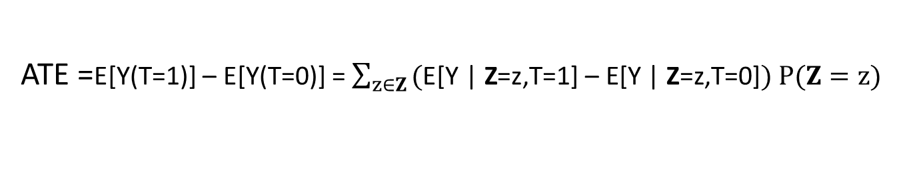
Assumption
Identifiability of causal effects required some untestable :
Ignitability Assumption:
Y(1),Y(0)
ATE =E[Y(T=1)] – E[Y(T=0)] = $\sum_{z∈Z}{\text{(}\text{E}\text{[}\text{Y}\text{ | }\text{Z}\text{=}\text{z}\text{,}\text{T}\text{=1] – }\text{E}\text{[}\text{Y}\text{ | }\text{Z}\text{=}\text{z}\text{,}\text{T}\text{=0]}) P(Z=z)}$

Slide 20
Outline
Motivation & Background
Our system
Detecting Bias
Explaining Bias
Resolving Bias
Experiments
Conclusions
Notes:
With this motivation and background I am going to discuss briefly different components of our system

Slide 21
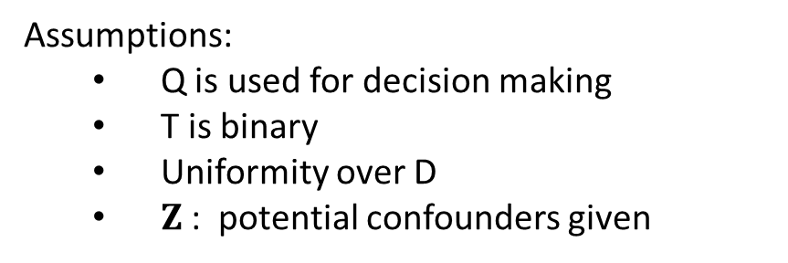
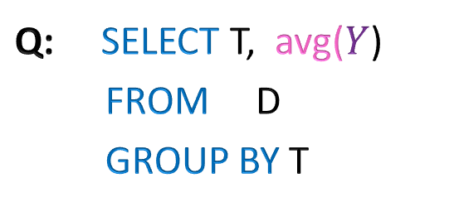
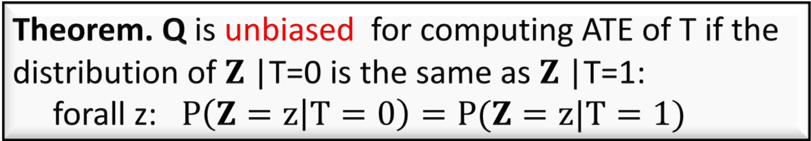
Unbiased Queries
Q: SELECT T, avg($Y$)
FROM D
GROUP BY T
Assumptions:
Q is used for decision making
T is binary
Uniformity over D
$Z$: potential confounders given
Informally: Q is unbiased if the difference between its answers is equal to the ATE
Theorem. Q is unbiased for computing ATE of T if the distribution of $Z$|T=0 is the same as $Z$|T=1: forall z: $P\left(Z=z | T=0\right)=P(Z=z|T=1)$
Notes:
(on any outcome!)

Slide 22

Unbiased Queries
Q: SELECT T, avg($Y$)
FROM D
GROUP BY T
Assumptions:
Q is used for decision making
T is binary
Uniformity over D
$Z$: potential confounders given
Informally: Q is unbiased if the difference between its answers is equal to the ATE
Theorem. Q is unbiased for computing ATE of T if the distribution of $Z$|T=0 is the same as $Z$|T=1: forall z: $P\left(Z=z | T=0\right)=P(Z=z|T=1)$
Bias can be detected by testing if $Z$ and T are not independent
Notes:
(on any outcome!)

Slide 23




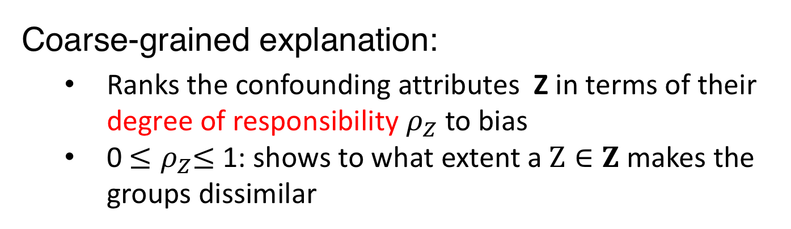
Explain Bias
Suppose Q is biased wrt. $Z=\{Z_{1},Z_{2},…,Z_{k}\}$
Q: SELECT T, avg($Y$)
FROM D
GROUP BY T
$${ Z}_{1}$$
$${ Z}_{2}$$
…
$${ Z}_{k}$$
T
Y
Coarse-grained explanation:
Ranks the confounding attributes Z in terms of their degree of responsibility $ρ_{Z}$ to bias
0 ${≤ρ}_{Z}≤$ 1: shows to what extent a $Z∈Z$ makes the groups dissimilar
Notes:
Now that we lknow how to detect bias, lets see how we hypdb can explain it.
Hypdb generates two classes of explanations for bias: coarse and fine
To generate coarse, it ….
We defined the notion of resposnsibility as a quantity between 0 and 1 which …

Slide 24
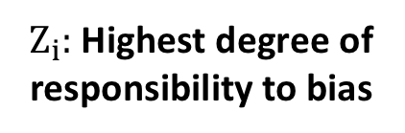


Explain Bias
Suppose Q is biased wrt. $Z=\{Z_{1},Z_{2},…,Z_{k}\}$
Q: SELECT T, avg($Y$)
FROM D
GROUP BY T
$${ Z}_{i}$$
${ Z}_{i}:$ Highest degree of
responsibility to bias
T
Y
Fine-grained explanation:
Ranks ($z_{i}$ ,y, t) $∈$ Dom(${ Z}_{i}$, T, Y ) in term of their degree of contribution to the fake correlation induced by the confounding path: T ← $Z_{i}$ → Y
Notes:
Now lets see how hypdb generate finer expalanations
But before that recall

Slide 25
Example
Q: Which airline has a better on-time performance?
OLAP Query:
SELECT avg(Delayed), Carrier
FROM Flightdata WHERE Carrier IN (American, United ) GROUP BY Carrier
Suppose Z={Airport, Year, Month, Day, Hour}
Notes:
Digging deeper for Airport, these are the particular fine-grained explanations
Roc has lots of delays and UA has lots of flight ..

Slide 26

Example
Q: Which airline has a better on-time performance?
OLAP Query:
SELECT avg(Delayed), Carrier
FROM Flightdata WHERE Carrier IN (American, United ) GROUP BY Carrier
Suppose Z={Airport, Year, Month, Day, Hour}
The query is biased because $Z$ and $T$ are highly dependent
Notes:
AA flies to airports that have few delays (COS, MFE)
UA flies to airports that have many delays (MTJ, ROC)
Say aiport names cleare
Returing to pour example. Using tech. that I’d explain later we establish a causal Dag from which a fragment is shown
I show a fragment of these data
We are computing causal graphs using all the attributes.
Digging deeper for Aiport, these are the particular fine-grained explanations
Roc has lots of delays and UA has lots of flight ..

Slide 27
Example
Q: Which airline has a better on-time performance?
OLAP Query:
SELECT avg(Delayed), Carrier
FROM Flightdata WHERE Carrier IN (American, United ) GROUP BY Carrier
Suppose Z={Airport, Year, Month, Day, Hour}
The query is biased because $Z$ and $T$ are highly dependent
Coarse-Grained:
Attribute | Res.
Airport | 0.72
Year | 0.16
…
Notes:
AA flies to airports that have few delays (COS, MFE)
UA flies to airports that have many delays (MTJ, ROC)
Say aiport names cleare
Returing to pour example. Using tech. that I’d explain later we establish a causal Dag from which a fragment is shown
I show a fragment of these data
We are computing causal graphs using all the attributes.
Digging deeper for Aiport, these are the particular fine-grained explanations
Roc has lots of delays and UA has lots of flight ..

Slide 28
Example
Q: Which airline has a better on-time performance?
OLAP Query:
SELECT avg(Delayed), Carrier
FROM Flightdata WHERE Carrier IN (American, United ) GROUP BY Carrier
Suppose Z={Airport, Year, Month, Day, Hour}
The query is biased because $Z$ and $T$ are highly dependent
Coarse-Grained:
Fine-Grained(top two):
Attribute | Res.
Airport | 0.72
Year | 0.16
…
Rank | Carrier | Airport | Delayed
1 | United | ROC | 1
2 | American | MFE | 0
Notes:
AA flies to airports that have few delays (COS, MFE)
UA flies to airports that have many delays (MTJ, ROC)
Say aiport names cleare
Returing to pour example. Using tech. that I’d explain later we establish a causal Dag from which a fragment is shown
I show a fragment of these data
We are computing causal graphs using all the attributes.
Digging deeper for Aiport, these are the particular fine-grained explanations
Roc has lots of delays and UA has lots of flight ..

Slide 29
Example
Q: Which airline has a better on-time performance?
OLAP Query:
SELECT avg(Delayed), Carrier
FROM Flightdata WHERE Carrier IN (American, United ) GROUP BY Carrier
Suppose Z={Airport, Year, Month, Day, Hour}
The query is biased because $Z$ and $T$ are highly dependent
Coarse-Grained:
Fine-Grained(top two):
Attribute | Res.
Airport | 0.72
Year | 0.16
…
Rank | Carrier | Airport | Delayed
1 | United | ROC | 1
2 | American | MFE | 0
United frequently flies from Rochester (ROC) that has several delays
American frequently flies from McAllen Miller (MFE) that has fewer delays
Notes:
AA flies to airports that have few delays (COS, MFE)
UA flies to airports that have many delays (MTJ, ROC)
Say aiport names cleare
Returing to pour example. Using tech. that I’d explain later we establish a causal Dag from which a fragment is shown
I show a fragment of these data
We are computing causal graphs using all the attributes.
Digging deeper for Aiport, these are the particular fine-grained explanations
Roc has lots of delays and UA has lots of flight ..
Therefore, the query is biased in favor of American.
These would explain why the query is biased and why it leasds to Simpsons paradox. Indeed any comparison between these acrriers …
This would make the comparison between United and American unfair without accounting for the fact they do not operate evenly at all aiports!

Slide 30
Example
Q: Which airline has a better on-time performance?
OLAP Query:
SELECT avg(Delayed), Carrier
FROM Flightdata WHERE Carrier IN (American, United ) GROUP BY Carrier
Suppose Z={Airport, Year, Month, Day, Hour}
The query is biased because $Z$ and $T$ are highly dependent
Coarse-Grained:
Fine-Grained(top two):
Attribute | Res.
Airport | 0.72
Year | 0.16
…
Rank | Carrier | Airport | Delayed
1 | United | ROC | 1
2 | American | MFE | 0
United frequently flies from Rochester (ROC) that has several delays
American frequently flies from McAllen Miller (MFE) that has fewer delays
Notes:
NOte
As you see Rochester has lots of delay and united happens to have many flight from Rochester. While American has many frlight from MFE where there are feq delays in general. That’s why American has fewr average delay in general.
AA flies to airports that have few delays (COS, MFE)
UA flies to airports that have many delays (MTJ, ROC)
Say aiport names cleare
Returing to pour example. Using tech. that I’d explain later we establish a causal Dag from which a fragment is shown
I show a fragment of these data
We are computing causal graphs using all the attributes.
Digging deeper for Aiport, these are the particular fine-grained explanations
+++ to confirm these explanation check out these two plots: the first one show the frequency of flight belong to each airline in different aiports; the second one shows the average delayed flight in each airport:
Roc has lots of delays and UA has lots of flight ..

Slide 31
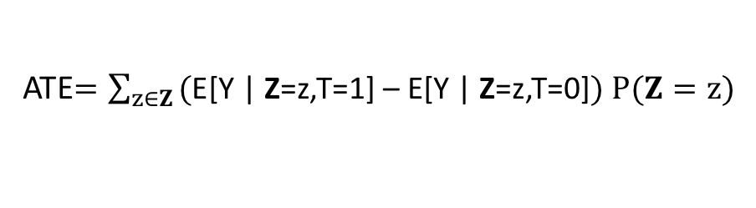
Rewriting Query to Remove Bias
Q: Which airline has a better on-time performance?
E[Y|T=1] – E[Y|T=0]
ATE$=\sum_{z∈Z}{\text{(}\text{E}\text{[}\text{Y}\text{ | }\text{Z}\text{=}\text{z}\text{,}\text{T}\text{=1] – }\text{E}\text{[}\text{Y}\text{ | }\text{Z}\text{=}\text{z}\text{,}\text{T}\text{=0]}) P(Z=z)}$
Z={Airport, Year, Month, Day, Hour}
OLAP Query:
SELECT avg(Delayed), Carrier
FROM Flightdata WHERE Carrier IN ( 'AA', 'UA' ) GROUP BY Carrier
Rewritten Query:
WITH Blocks AS(
SELECT Carrier,Z, avg(Delayed) AS Avge
FROM FlightData
WHERE Carrier in ('AA ','UA ‘)
GROUP BY Carrier,Z),
Weights AS(
SELECT Z, count (*)/n AS W
FROM FlightData
WHERE Carrier in ('AA ','UA ‘)
GROUP BY
HAVING count ( DISTINCT Carrier)=2)),
SELECT Carrier,sum( Avge * W)
FROM Blocks , Weights
WHERE Blocks .Z = Weights .Z
GROUP BY Carrier
Rewriting
Intuition:
Computes the average delay of each carrier at blocks consists of same airport, year, day and hour
Take the expected value of the delays across blocks
Notes:
Now lets see how hypdb eliminate bias from the query with the running example.
The rewriting is inspired from the equation we observed earlier for computing ATE!
The intuition behind this rewriting is pretty simple,
Intuition: Compute the query on groups that are homogenous on Z

Slide 32
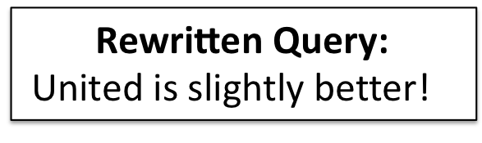
Rewriting Query to Remove Bias
Q: Which airline has a better on-time performance?
E[Y|T=1] – E[Y|T=0]
ATE$=\sum_{z∈Z}{\text{(}\text{E}\text{[}\text{Y}\text{ | }\text{Z}\text{=}\text{z}\text{,}\text{T}\text{=1] – }\text{E}\text{[}\text{Y}\text{ | }\text{Z}\text{=}\text{z}\text{,}\text{T}\text{=0]}) P(Z=z)}$
Z={Airport, Year, Month, Day, Hour}
OLAP Query:
SELECT avg(Delayed), Carrier
FROM Flightdata WHERE Carrier IN ( 'AA', 'UA' ) GROUP BY Carrier
Rewritten Query:
WITH Blocks AS(
SELECT Carrier,Z, avg(Delayed) AS Avge
FROM FlightData
WHERE Carrier in ('AA ','UA ‘)
GROUP BY Carrier,Z),
Weights AS(
SELECT Z, count (*)/n AS W
FROM FlightData
WHERE Carrier in ('AA ','UA ‘)
GROUP BY
HAVING count ( DISTINCT Carrier)=2)),
SELECT Carrier,sum( Avge * W)
FROM Blocks , Weights
WHERE Blocks .Z = Weights .Z
GROUP BY Carrier
Rewriting
$$\text{Rewritten} \text{Query}\text{:}$$
United is slightly better!

Slide 33
Other Key Contributions
A novel algorithm to learn confounders by performing a few independence tests
is more robust than state of the art algorithms
employs cashing and view materialization to achieve an order of magnitude speedup
can be computed at query time using data cubes
Optimizations to speed up Monte Carlo permutation test for independence
Hours (shuffling data) Less than a second (our method)!
Notes:
The most cobust method for
which is a robust, but computationally expensive independence
Our optimization
consists of generating permutation samples without shuffling of
data, by sampling from contingency tables and conditioning groups.

Slide 34
Outline
Motivation & Background
Our system
Detecting Bias
Explaining Bias
Resolving Bias
Experiments
Conclusions

Slide 35
End to End Evaluation
Q: What is the effect of Gender on adult Income?
[UCI Adult Census dataset ]
OLAP Query:
SELECT avg(Income)
FROM AdultData
GROUP BY Gender
This dataset has been widely used in fairness literature for discrimination discovery:
[Luong et. Al., KDD 2011],
[Zliobaite et. al., ICDM 2011],
[Hajian et. al., TKDE 2013], [Kamishima et. al., PKDD 2013],
[Zemel et. al., PKDD 2013],
[Florian et. al., EuroS&P 2017],
[[Calmon et. al., NIPS 2017],
[Nabi et. al., AAAI 2018], …
Notes:
Our first application of HypDB was to replicate some experiments from the literature concerning fairness, which had been conducted on a particular datasets frequently used in the literature, namely the ”adults datasets from UCI”; which reports census data and income (under or over $50K) for 48,842 U.S. citizens.
A typical investigation, e.g. done by [XXXX], compute the average income for male and female and report a discrepancy.
Let me show you a use case of HypDB in studying discrimination in social datasets: We use the Adult dataset [52], which reports census data and income (under or over $50K) for 48,842 U.S. citizens. This dataset has been studied in several work in the context of fairness. We used the same dataset to replicate their results and confirm them.

Slide 36
End to End Evaluation
Q: What is the effect of Gender on adult Income?
[UCI Adult Census dataset ]
OLAP Query:
SELECT avg(Income)
FROM AdultData
GROUP BY Gender
This dataset has been widely used in fairness literature for discrimination discovery:
[Luong et. Al., KDD 2011],
[Zliobaite et. al., ICDM 2011],
[Hajian et. al., TKDE 2013], [Kamishima et. al., PKDD 2013],
[Zemel et. al., PKDD 2013],
[Florian et. al., EuroS&P 2017],
[[Calmon et. al., NIPS 2017],
[Nabi et. al., AAAI 2018], …
Notes:
=================
…and report a discrepancy.

Slide 37
End to End Evaluation
Q: What is the effect of Gender on adult Income?
[UCI Adult Census dataset ]
OLAP Query:
SELECT avg(Income)
FROM AdultData
GROUP BY Gender
HypDB: query is biased wrt. attributes such as: MaritalStatus, Education, Age, …
Notes:
AA flies to airports that have few delays (COS, MFE)
UA flies to airports that have many delays (MTJ, ROC)
Say aiport names cleare
Returing to pour example. Using tech. that I’d explain later we establish a causal Dag from which a fragment is shown
I show a fragment of these data
We are computing causal graphs using all the attributes.
Digging deeper for Aiport, these are the particular fine-grained explanations
Roc has lots of delays and UA has lots of flight ..
================
We applied HypDB to this simple query, and, TO OUR SURPRISE, we found that the query is actually biased, with confounding variables …

Slide 38
End to End Evaluation
Q: What is the effect of Gender on adult Income?
[UCI Adult Census dataset ]
OLAP Query:
SELECT avg(Income)
FROM AdultData
GROUP BY Gender
HypDB: query is biased wrt. attributes such as: MaritalStatus, Education, Age, …
Coarse-Grained:
Attribute | Res.
MaritalStatus | 0.58
Education | 0.13
… | …
Notes:
AA flies to airports that have few delays (COS, MFE)
UA flies to airports that have many delays (MTJ, ROC)
Say aiport names cleare
Returing to pour example. Using tech. that I’d explain later we establish a causal Dag from which a fragment is shown
I show a fragment of these data
We are computing causal graphs using all the attributes.
Digging deeper for Aiport, these are the particular fine-grained explanations
Roc has lots of delays and UA has lots of flight ..
================
Digging deeper with HypDB, we found that the most responsible confounder was MaritalStatus.

Slide 39
End to End Evaluation
Q: What is the effect of Gender on adult Income?
[UCI Adult Census dataset ]
OLAP Query:
SELECT avg(Income)
FROM AdultData
GROUP BY Gender
HypDB: query is biased wrt. attributes such as: MaritalStatus, Education, Age, …
Coarse-Grained:
Attribute | Res.
MaritalStatus | 0.58
Education | 0.13
… | …
Fine-Grained:
Rank | Gender | MarialStatus | Income
1 | Male | Married | 1
2 | Female | Single | 0
There are more married males than married females in data and
married people have higher income!
Notes:
AA flies to airports that have few delays (COS, MFE)
UA flies to airports that have many delays (MTJ, ROC)
Say aiport names cleare
Returing to pour example. Using tech. that I’d explain later we establish a causal Dag from which a fragment is shown
I show a fragment of these data
We are computing causal graphs using all the attributes.
Digging deeper for Aiport, these are the particular fine-grained explanations
Roc has lots of delays and UA has lots of flight ..

Slide 40
End to End Evaluation
Q: What is the effect of Gender on adult Income?
[UCI Adult Census dataset ]
OLAP Query:
SELECT avg(Income)
FROM AdultData
GROUP BY Gender
HypDB: query is biased wrt. attributes such as: MaritalStatus, Education, Age, …
Income attribute in US census data reports the adjusted gross income as indicated in the individual’s tax forms, which depends on filing status could be household income
Notes:
Extraction was done by Barry Becker from the 1994 Census database.
AA flies to airports that have few delays (COS, MFE)
UA flies to airports that have many delays (MTJ, ROC)
Say aiport names cleare
Returing to pour example. Using tech. that I’d explain later we establish a causal Dag from which a fragment is shown
I show a fragment of these data
We are computing causal graphs using all the attributes.
Digging deeper for Aiport, these are the particular fine-grained explanations
Roc has lots of delays and UA has lots of flight ..
http://robotics.stanford.edu/~ronnyk/
Ron Kohavi, PhD

Slide 41
End to End Evaluation
Q: What is the effect of Gender on adult Income?
[UCI Adult Census dataset ]
OLAP Query:
SELECT avg(Income)
FROM AdultData
GROUP BY Gender
pvalue<0.005
Disparity is explained by other attributes to a huge extent. However, Adult census data is Inconsistent and SHOULD NOT be used to investigate gender discrimination
Notes:
Extraction was done by Barry Becker from the 1994 Census database.
AA flies to airports that have few delays (COS, MFE)
UA flies to airports that have many delays (MTJ, ROC)
Say aiport names cleare
Returing to pour example. Using tech. that I’d explain later we establish a causal Dag from which a fragment is shown
I show a fragment of these data
We are computing causal graphs using all the attributes.
Digging deeper for Aiport, these are the particular fine-grained explanations
Roc has lots of delays and UA has lots of flight ..
We have several other uses cases and experiments in the paper that I would not be able to cover today, please read the paper or come to my poster session to chat about them.

Slide 42
Outline
Motivation & Background
Our system
Detecting Bias
Explaining Bias
Resolving Bias
Experiments
Conclusions

Slide 43
Conclusions
OLAP queries can be biased and misleading
We proposed HypDB, a system to detect, explain, and resolve bias
HypDB is useful for:
Avoiding statistical anomalies
Detecting discrimination
Detecting errors in data collection
Notes:
6:10

Slide 44
References
[Luong et. al., KDD 2011] Luong, Binh Thanh, Salvatore Ruggieri, and Franco Turini. "k-NN as an implementation of situation testing for discrimination discovery and prevention."ACM SIGKDD. ACM, 2011.
[Zliobaite et. al., ICDM 2011] Zliobaite, F. Kamiran, and T. Calders, “Handling conditional discrimination,” in ICDM. IEEE, 2011, pp. 992–1001.
[Hajian et. al., TKDE 2013] S. Hajian and J. Domingo-Ferrer, “A methodology for direct and indirect discrimination prevention in data mining,” TKDE, vol. 25, no. 7, pp. 1445–1459, 2013.
[Hajian et. al., KDD 2015] M. Feldman, S. A. Friedler, J. Moeller, C. Scheidegger, and S. Venkatasubramanian, “Certifying and removing disparate impact,” in KDD. ACM, 2015, pp. 259–268.
[Kamishima et. al., PKDD 2013] T. Kamishima, S. Akaho, H. Asoh, and J. Sakuma, “Fairness-aware classifier with prejudice remover regularizer,” in ECML PKDD. Springer, 2012, pp. 35–50.
[Zemel et. al., PKDD 2013] R. Zemel, Y. Wu, K. Swersky, T. Pitassi, and C. Dwork, “Learning fair representations,” in ICML, 2013, pp. 325–333.
[Florian et. al., EuroS&P 2017] Tramer, Florian, et al. "FairTest: Discovering unwarranted associations in data-driven applications." Security and Privacy (EuroS&P), 2017 IEEE European Symposium on. IEEE, 2017.
[Calmon et. al., NIPS 2017] Calmon, Flavio, et al. "Optimized Pre-Processing for Discrimination Prevention." Advances in Neural Information Processing Systems. 2017.
[Razieh et. al., AAAI 2018] Nabi, Razieh, and Ilya Shpitser. "Fair inference on outcomes." Proceedings of the... AAAI Conference on Artificial Intelligence. AAAI Conference on Artificial Intelligence. Vol. 2018. NIH Public Access, 2018.

